Slide 1
WELCOME

Slide 2
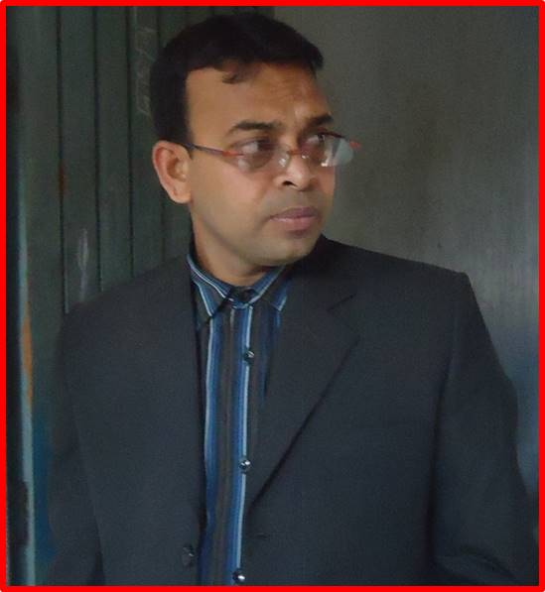
MD. KAMRUZZAMAN
SENIOR ASSISTANT TEACHER (Eng)
MUNSHIGANJ ACADEMY
ALAMDANGA, CHUADANGA
Moble No. 01916669760
E-mail : zamanlincoln@gmail.com

Slide 3
CLASS : 9/10
SUBJECT | : ENGLISH 1st Paper
UNIT | : 3
LESSON | : 5
PERIOD | : 3rd
TIME | : 50 MINUTES

Slide 4
LEARNING OUTCOME
By the end of the lesson, students will be able to-
say about Independence Day.
learn new words
describe the celebration of the Day.

Slide 5
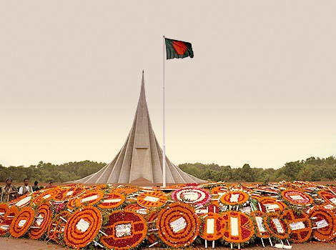
What can you see in the picture ?

Slide 6
TODAY’S LESSON
Independence Day

Slide 7
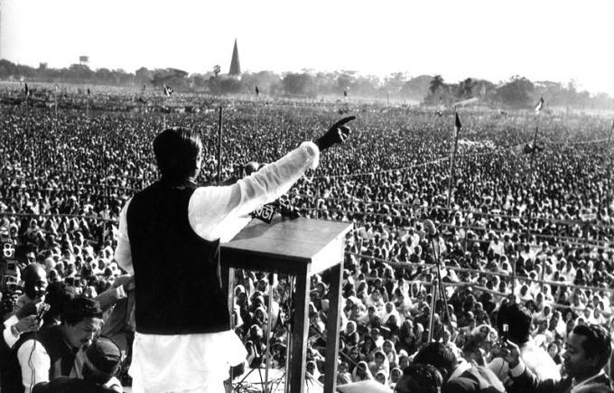
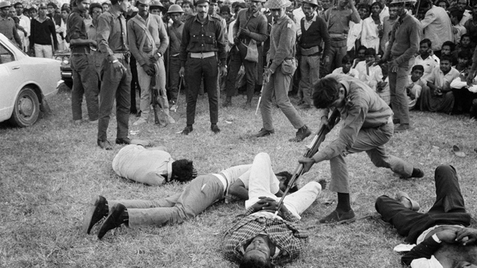
7th March Video
Declaration of Independence
Genocide of Pakistani Army

Slide 8
26th March, Our Independence Day, The biggest state festival.
It is a national holiday.
The Day is celebrated every year in the country with great enthusiasm and fervour.

Slide 9
Individual Work
What is Independence Day ?
When is the Day celebrated ?

Slide 10
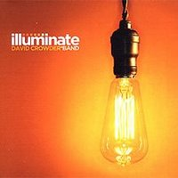
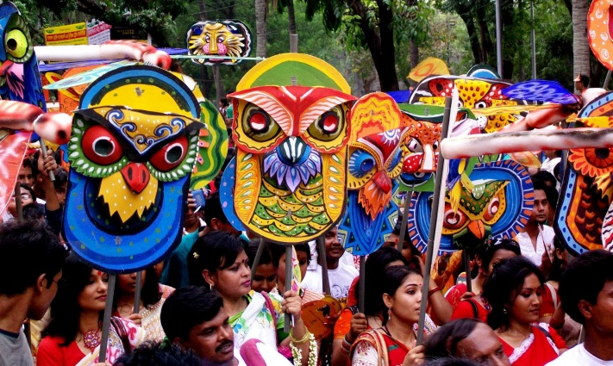
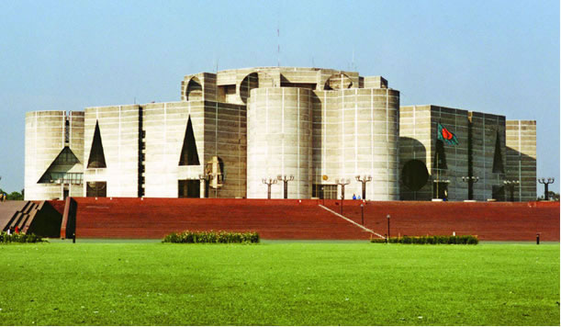
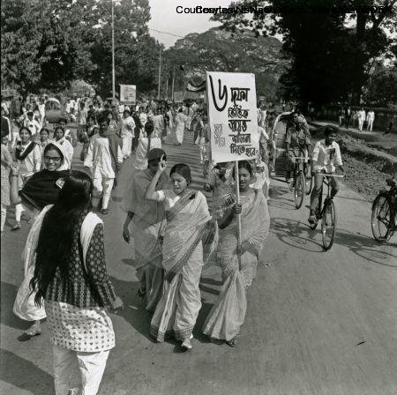

Slide 11
Individual Work
Write the meaning of these words
Festival | :
Wreath | :
Illuminate | :
Parliament | :
Procession | :

Slide 12
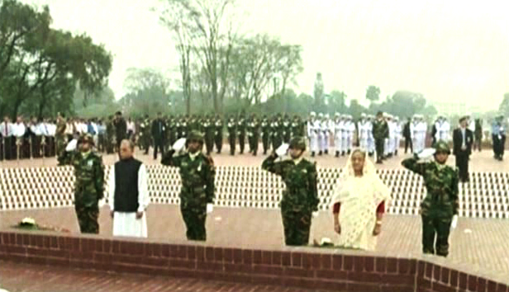
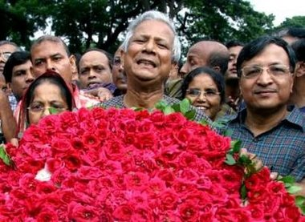
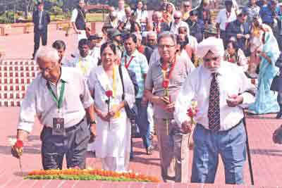
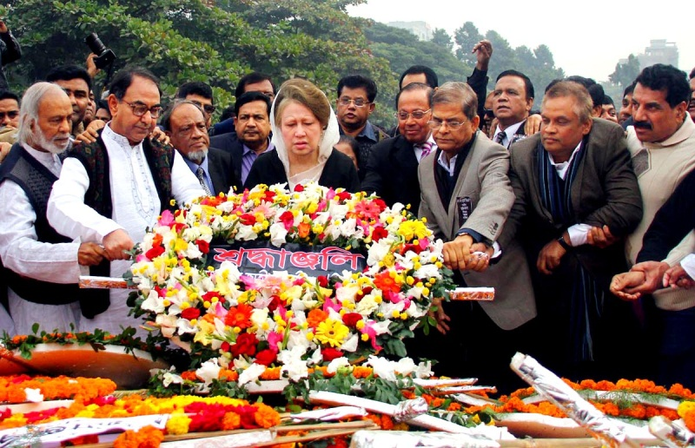
Offering Wreaths at National Mausoleum
Prime Minister &President
Social organisation
Diplomats
Political Parties

Slide 13
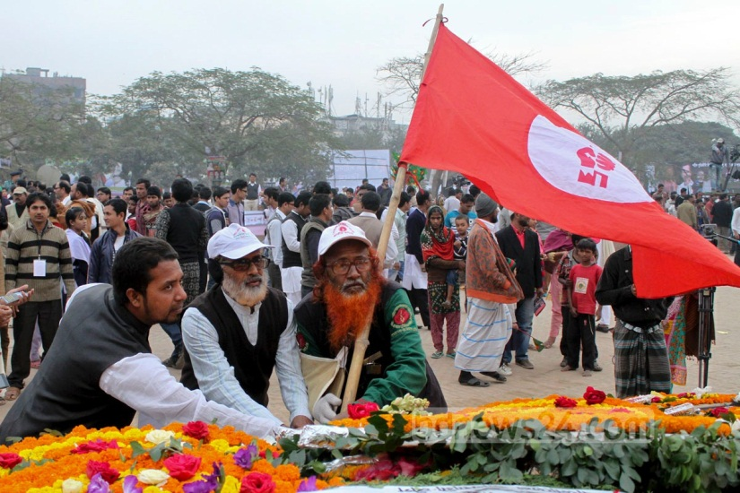
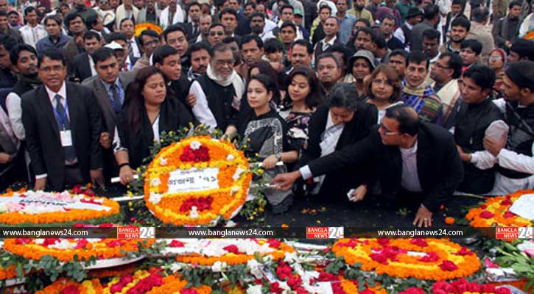
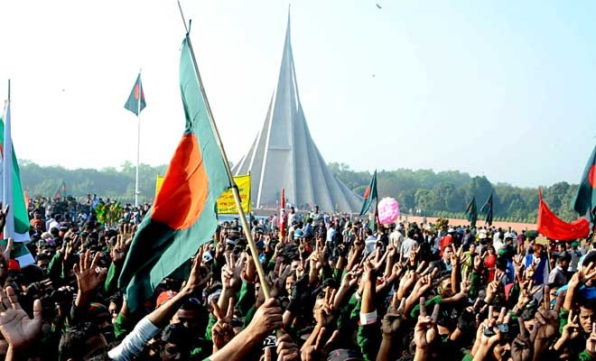
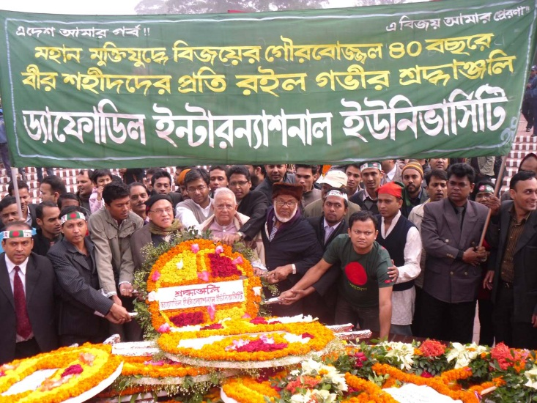
Offering Wreaths at National Mausoleum
Freedom Fighters
Cultural Organization
People from all walk of life
Institution

Slide 14
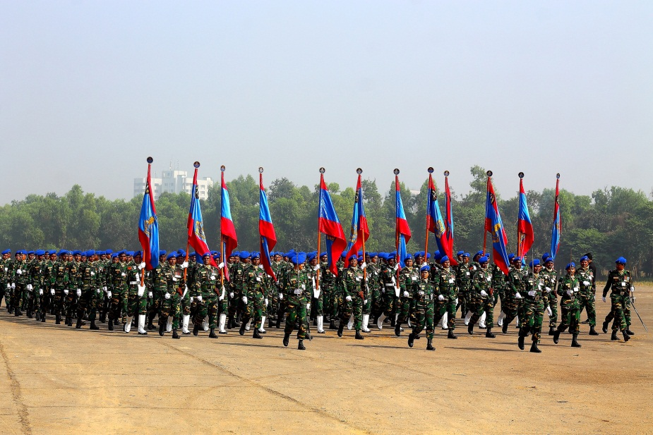
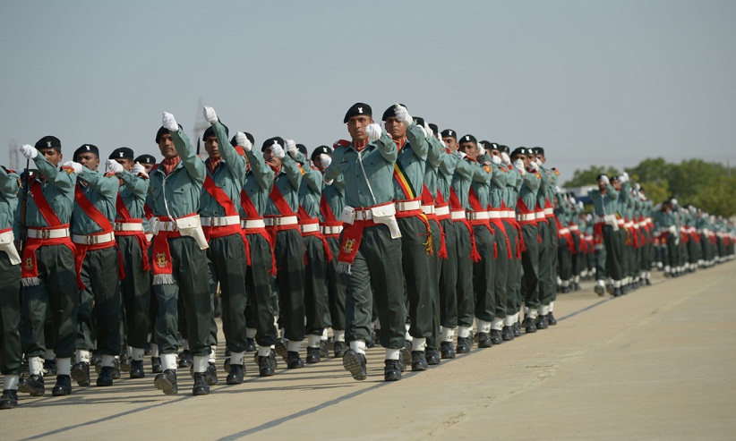
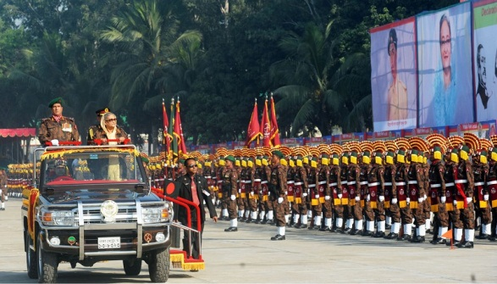
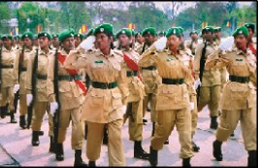
Parade of Defence Forces at National Parade Ground
Army
Police
BGB
Ansars

Slide 15
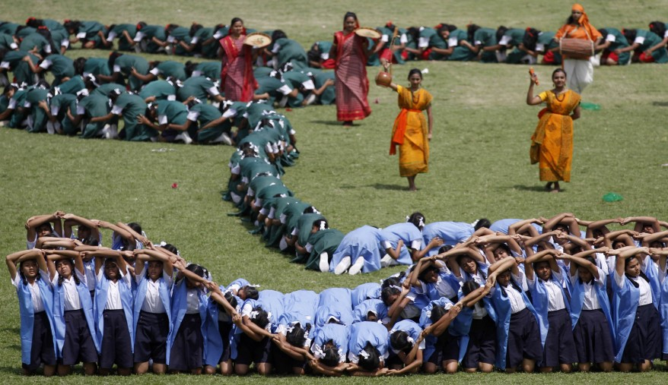
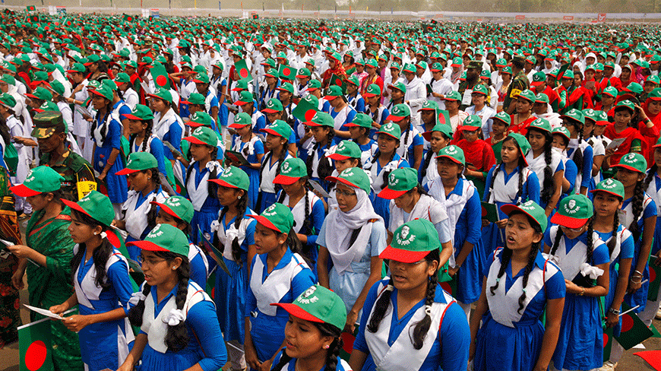
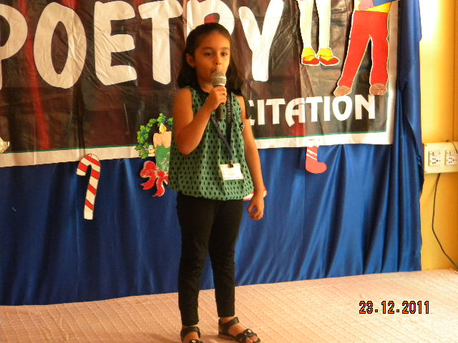
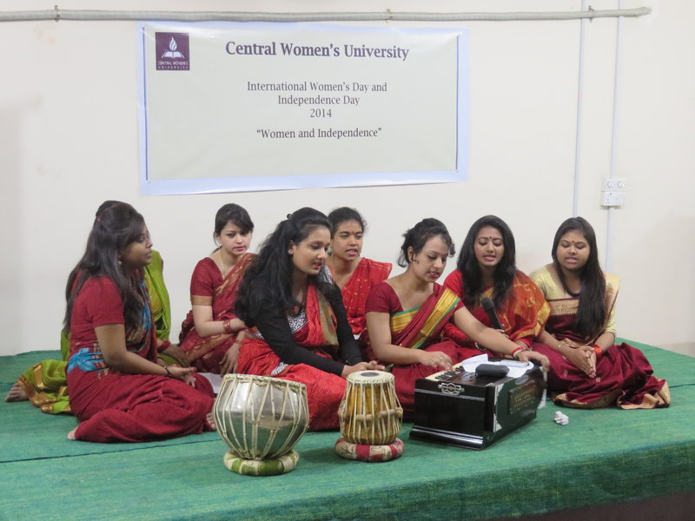
At Educational Institution
Display
Singing NationalAnthem
Reciting Poems
Musical Ceremony

Slide 16
Pair Work
Who offer wreaths at National
Mausoleum ?
b) Who parade at National Parade
Ground ?

Slide 17
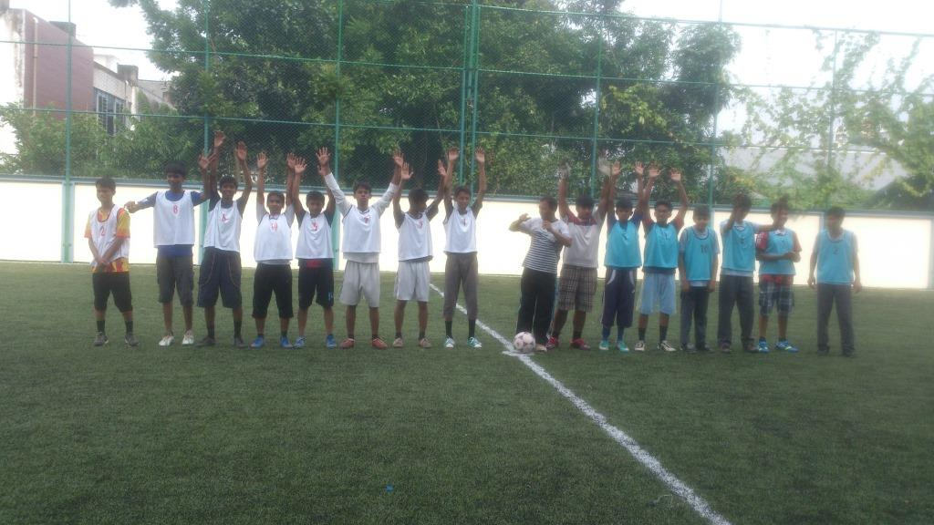
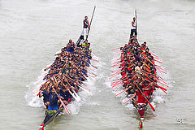
Tournament
Boat race

Slide 18
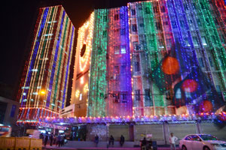
In the Evening
Major Buildings Illuminated with Colourful Lights

Slide 19
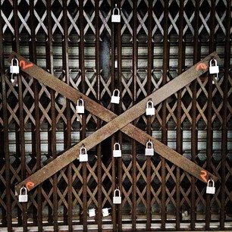
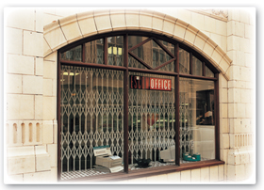
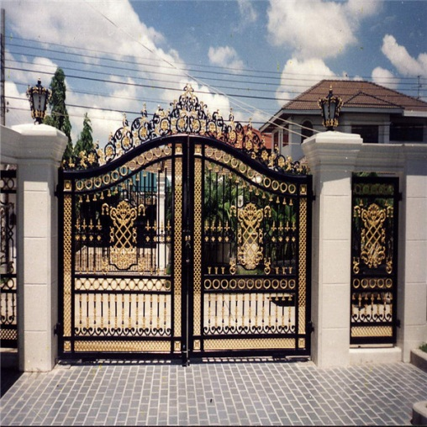
26 March is a national holiday
Shops remain closed
Factories are locked
Offices are closed

Slide 20
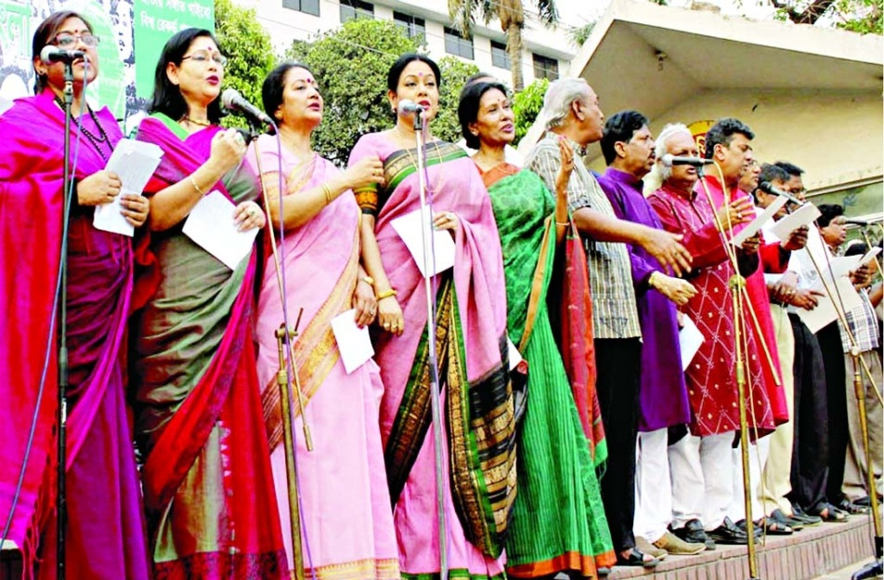
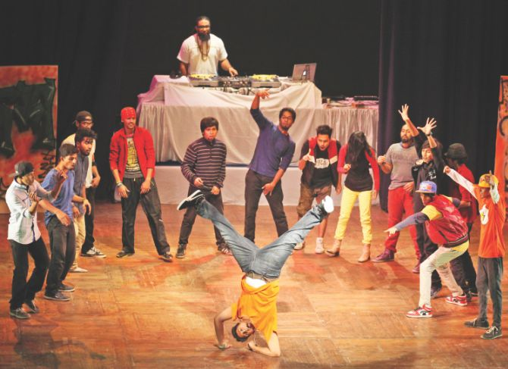
Musical Ceremony, held by Bangla Academy
Drama, Arranged by
Shilpakala Academy

Slide 21
GROUP WORK
How is the Day celebrated ? Write five points.

Slide 22
Evaluation
1. Who parade in Independence Day?
2. Which organizations offer wreaths
at the National Mausoleum ?
3. What is arranged by Shilpakala
Academy?

Slide 23
Home Work
Write a paragraph on how you will celebrate the Independence Day at your school this year.

Slide 24
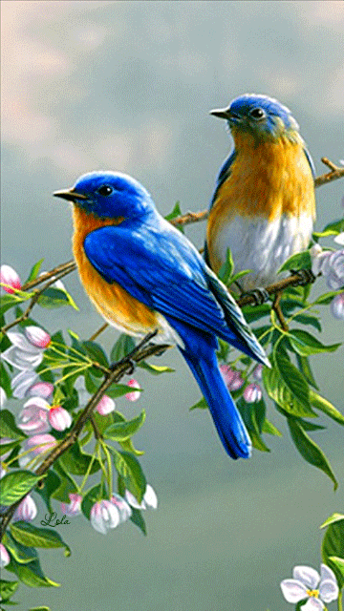
THANKS TO ALL

